Slide 1

Enginius
Conjoint Analysis – OfficeStar Case Study
Minder Chen, CSU Channel Islands
Copyright (c) 2022, DecisionPro Inc.

Slide 2
Steps in designing and executing a conjoint study.
Stage 1 - Designing the conjoint study:
  Step 1.1: Select attributes (4~6) relevant to the product or service category.
  Step 1.2: Select levels (between 2 to 4/5) for each attribute.
  Step 1.3: Develop the product bundles (profiles) by using factional factorial design to be evaluated. (not more than 25, preferrable 16 or less)
Stage 2 - Obtaining data from a sample of respondents:
  Step 2.1: Design a data-collection procedure of customers preferences of product profiles using methods such as pairwise comparison, ranking, or rating.
  Step 2.2: Select a computation method for obtaining partworth functions.
Stage 3 - Evaluating product design options:
  Step 3.1: Segment customers based on their partworth functions.
  Step 3.2: Design market simulations.
  Step 3.3: Select choice rule.
  Step 3.4: Adjust market shares to reflect support marketing programs.

Slide 3
Conjoint Analysis Input Data: Conjoint design
This table lists the conjoint study design: each column heading represents an attribute, and the values listed below them are the levels (options) available for each attribute.
\ | Location | Office supplies | Furniture | Computers
Level 1 | Less than 2 miles | Very large assortment | Office furniture | No computers
Level 2 | Within 2 to 5 miles | Large assortment | No furniture | Software only
Level 3 | Within 5 to 10 miles | Limited assortment |  | Software and computers
Potentially: 3x3x2x3 = =54 profiles ➔ Cut down to 13 profiles

Slide 4
Conjoint Analysis Input Data: Profiles to be rated (short format)
Profiles (Variety of attribute's levels combinations) data for short data format
產品特性選項不同組合的設計 ➔ 13 Profiles
➔ Enough for further analyses
Attribute\Profile | Profile 1 | Profile 2 | Profile 3 | Profile 4 | Profile 5 | Profile 6 | … | Profile 13
Location | Within 5 to 10 miles | Within 5 to 10 miles | Less than 2 miles | Less than 2 miles | Within 2 to 5 miles | Within 2 to 5 miles |  | Within 5 to 10 miles
Office supplies | Very large assortment | Large assortment | Limited assortment | Large assortment | Limited assortment | Very large assortment |  | Limited assortment
Furniture | Office furniture | Office furniture | Office furniture | No furniture | No furniture | Office furniture |  | No furniture
Computers | No computers | No computers | No computers | No computers | No computers | Software only |  | Software and computers

Slide 5
Conjoint Analysis Input Data: Profiles to be rated (short format)
Profiles (Variety of attribute's levels combinations) data for short data format
產品特性選項不同組合的設計 ➔ 13 Profiles by 20 Respondents
\ | Profile 1 | Profile 2 | Profile 3 | Profile 4 | Profile 5 | Profile 6 | … | Profile 13
Respondent 1 | 58 | 59 | 87 | 35 | 24 | 80 |  | 11
Respondent 2 | 5 | 9 | 33 | 38 | 16 | 22 |  | 61
Respondent 3 | 4 | 10 | 22 | 20 | 4 | 26 |  | 80
Respondent 4 | 56 | 31 | 26 | 39 | 17 | 90 |  | 27
Respondent 5 | 68 | 48 | 33 | 73 | 18 | 67 |  | 16
Respondent 6 | 50 | 40 | 77 | 63 | 19 | 65 |  | 0
Respondent 7 | 60 | 65 | 91 | 44 | 23 | 67 |  | 12
Respondent 8 | 11 | 12 | 25 | 35 | 10 | 14 |  | 69
…
Respondent 20 | 50 | 53 | 50 | 64 | 18 | 62 |  | 21
(see Conjoint Technical Note at https://www.enginius.biz/index.php/instructors/teaching-resources/technical-notes/ more details) to create the minimum number of profiles required to extract the partworths correctly.

Slide 6
Conjoint Analysis Input Data: Profiles to be rated (long format)
Customers' preference partworths can either be submitted as is, or inferred from customers' ratings of hypothetical profiles.
Id | Respondent | Location | Office supplies | Furniture | Computers | Rating
1-Profile 1 | 1 | Within 5 to 10 miles | Very large assortment | Office furniture | No computers | 58
2-Profile 2 | 1 | Within 5 to 10 miles | Large assortment | Office furniture | No computers | 59
3-Profile 3 | 1 | Less than 2 miles | Limited assortment | Office furniture | No computers | 87
4 | 1 | Less than 2 miles | Large assortment | No furniture | No computers | 35
5 | 1 | Within 2 to 5 miles | Limited assortment | No furniture | No computers | 24
6 | 1 | Within 2 to 5 miles | Very large assortment | Office furniture | Software only | 80
7 | 1 | Less than 2 miles | Limited assortment | Office furniture | Software only | 86
8 | 1 | Within 5 to 10 miles | Large assortment | No furniture | Software only | 3
9 | 1 | Less than 2 miles | Large assortment | Office furniture | Software and computers | 100
10 | 1 | Within 2 to 5 miles | Large assortment | Office furniture | Software and computers | 92
11 | 1 | Within 5 to 10 miles | Limited assortment | Office furniture | Software and computers | 66
12 | 1 | Less than 2 miles | Very large assortment | No furniture | Software and computers | 44
13-Profile 13 | 1 | Within 5 to 10 miles | Limited assortment | No furniture | Software and computers | 11
14-Profile 1 | 2 | Within 5 to 10 miles | Very large assortment | Office furniture | No computers | 5
15-Profile 2 | 2 | Within 5 to 10 miles | Large assortment | Office furniture | No computers | 9
16-Profile 3 | 2 | Less than 2 miles | Limited assortment | Office furniture | No computers | 33
…
The short format ratings will consist of two data blocks. 1. the profiles and 2. Profile ratings by respondents.
The long format has only one data block.

Slide 7
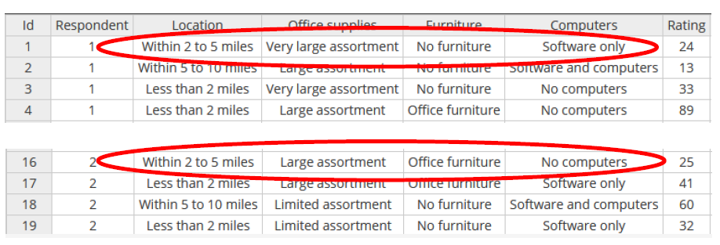
Conjoint ratings (long format)
Long format ratings are used when each respondent rated different conjoint profiles (shown below). These ratings are then used by Enginius to infer respondents’ partworths (preferences). With this option, every respondent can be exposed to different profiles and even different number of profiles (i.e., each respondent has his or her own customized or randomized questionnaire).
➔ Only one instead of two data blocks (no need for Profiles to be rated)

Slide 8
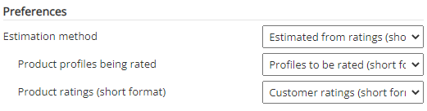
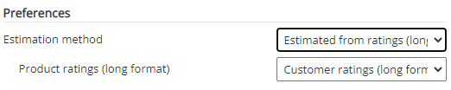
Select Data Blocks
Short format for Preferences: Two Data Blocks
Long format for Preferences: One Data Block

Slide 9
Conjoint Analysis Input Data: Conjoint design restriction
This table lists attribute levels that can be used in the search for an optimal product. In this example, only stores located within 5-10 miles are of the study's interest. Total possible combinations = 18
18 = 1 x 3 x 2 x 3
Lev.\Attri | Location | Office supplies | Furniture | Computers
Level 1 | Within 2 to 5 miles | Very large assortment | Office furniture | No computers
Level 2 |  | Large assortment | No furniture | Software only
Level 3 |  | Limited assortment |  | Software and computers

Slide 10

Incremental Revenue
\ | Location | Office supplies | Furniture | Computers
Level 1 | 0 | -15 | -30 | 0
Level 2 | 70 | 0 | 0 | -10
Level 3 | 100 | 20 |  | -40
\ | Location | Office supplies | Furniture | Computers
Level 1 | Less than 2 miles | Very large assortment | Office furniture | No computers
Level 2 | Within 2 to 5 miles | Large assortment | No furniture | Software only
Level 3 | Within 5 to 10 miles | Limited assortment |  | Software and computers
* This table summarizes how much more (+) or less (-) revenue would be generated by each option, compared to a base option. ➔ The base option is assumed to be 100 revenue by default

Slide 11
Existing Competitors
\ | Location | Office supplies | Furniture | Computers
Office Equipment | Within 2 to 5 miles | Large assortment | Office furniture | Software and computers
Department Store | Within 2 to 5 miles | Limited assortment | No furniture | Software only

Slide 12
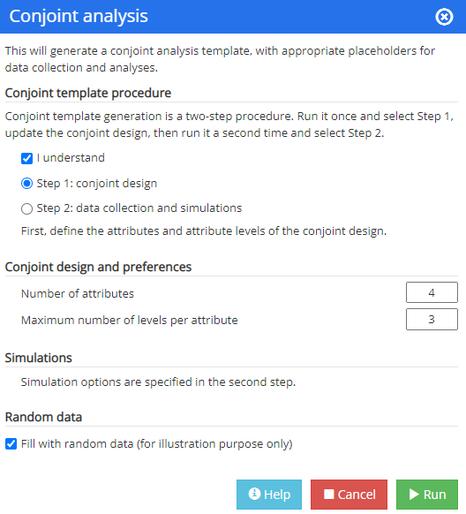
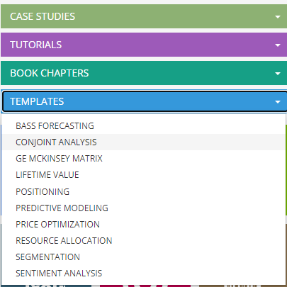
Conjoint Analysis: Create Templates
Conjoint template procedure
Conjoint templates generation is a two-step procedure. Run it once and select Step 1,
update the conjoint design, then run it a second time and select Step 2.
attributes (4~6)
levels (2~5)
Start from scratch

Slide 13
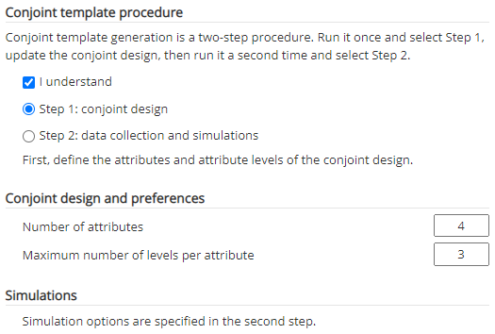
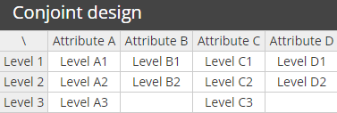
Step 1: Create Conjoint Design Template
Create a Conjoint Design template for data gathering
Define the following parameters
Number of attributes
Maximum number of levels per attribute

Slide 14
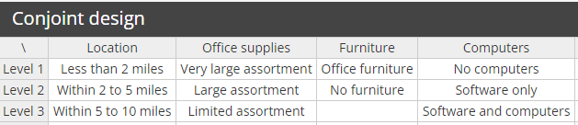
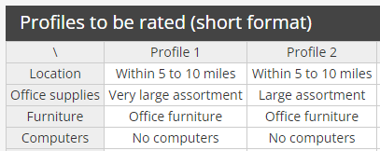
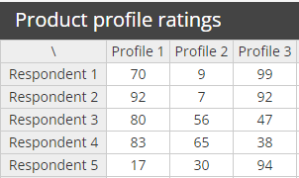
Templates Created in 2 Steps
Step 1
Customize for your own study (between step 1 & step 2)
Step 2
Create profiles to be rated
Create product profile ratings template
Gather customer ratings against profiles then enter them to the template before conducting Conjoint Analysis

Slide 15
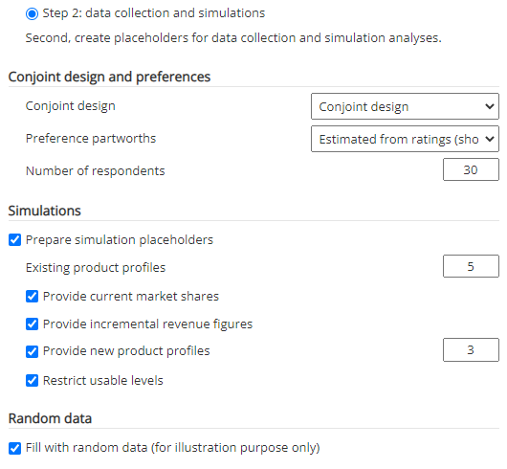
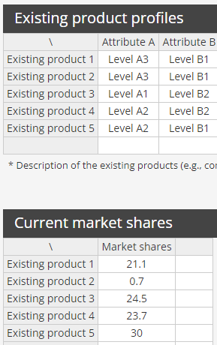
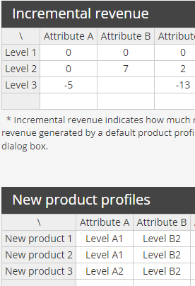
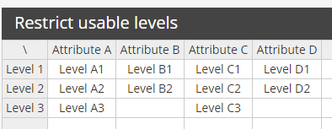
Create Additional Templates for Simulation Purpose based on
Conjoint Design & Preference Part-worths (屬性水平偏好, 效用函數)

Slide 16
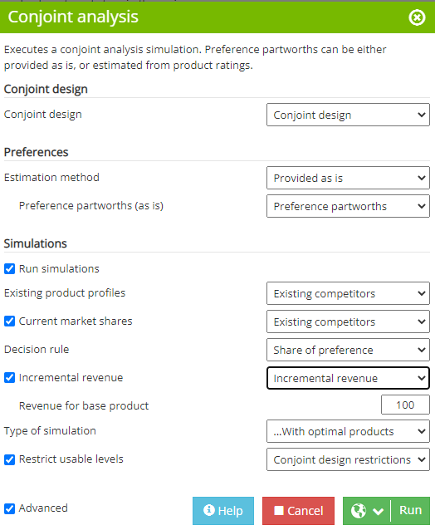
Conduct Conjoint Analysis and Run the Simulation: OfficeStar

Slide 17
OfficeStar
Report preference partworths
Conjoint analysis uses data pertaining to customers’ overall preferences for a selected number of product bundles and decomposes them into the utility values (partworths) that customers assign to each level of each attribute. The set of decomposed utility values thus represents the partworth function.
To collect data for conjoint analysis, the firm obtains respondents’ preferences for a carefully selected set of product bundles (i.e., profiles). The selected bundles typically do not include those that dominate the other bundles on all attributes of interest. Respondents rate or rank-order the bundles to indicate their degree of preference for each, which means they must trade off among attributes, because one product bundle may have their preferred level of one attribute (e.g., pepperoni topping) but contain less preferred levels of others (e.g., higher price and no vegetables).
These preference data enable the firm to derive partworth functions, which it then uses to predict respondents’ preferences for any product (i.e., any combination of attribute levels), even those not directly evaluated by respondents.

Slide 18
Preference Partworths
 | Average | Std dev. | Minimum | Maximum
Less than 2 miles | 27.0 | 10.6 | 14.2 | 49.7
Within 2 to 5 miles | 11.7 | 6.4 | 0.6 | 23.9
Within 5 to 10 miles | 0.0 | 0.0 | 0.0 | 0.0
Very large assortment | 22.6 | 20.7 | 0.0 | 59.0
Large assortment | 16.6 | 11.7 | 2.4 | 40.7
Limited assortment | 0.9 | 3.4 | 0.0 | 15.3
Office furniture | 14.7 | 18.9 | 0.0 | 54.5
No furniture | 1.8 | 3.9 | 0.0 | 12.9
No computers | 3.4 | 5.2 | 0.0 | 22.2
Software only | 5.9 | 8.1 | 0.0 | 22.8
Software and computers | 30.1 | 26.3 | 0.0 | 78.4
Average and standard statistics for preference partworths.
https://conjointly.com/guides/how-to-calculate-partworth-utilities/

Slide 19
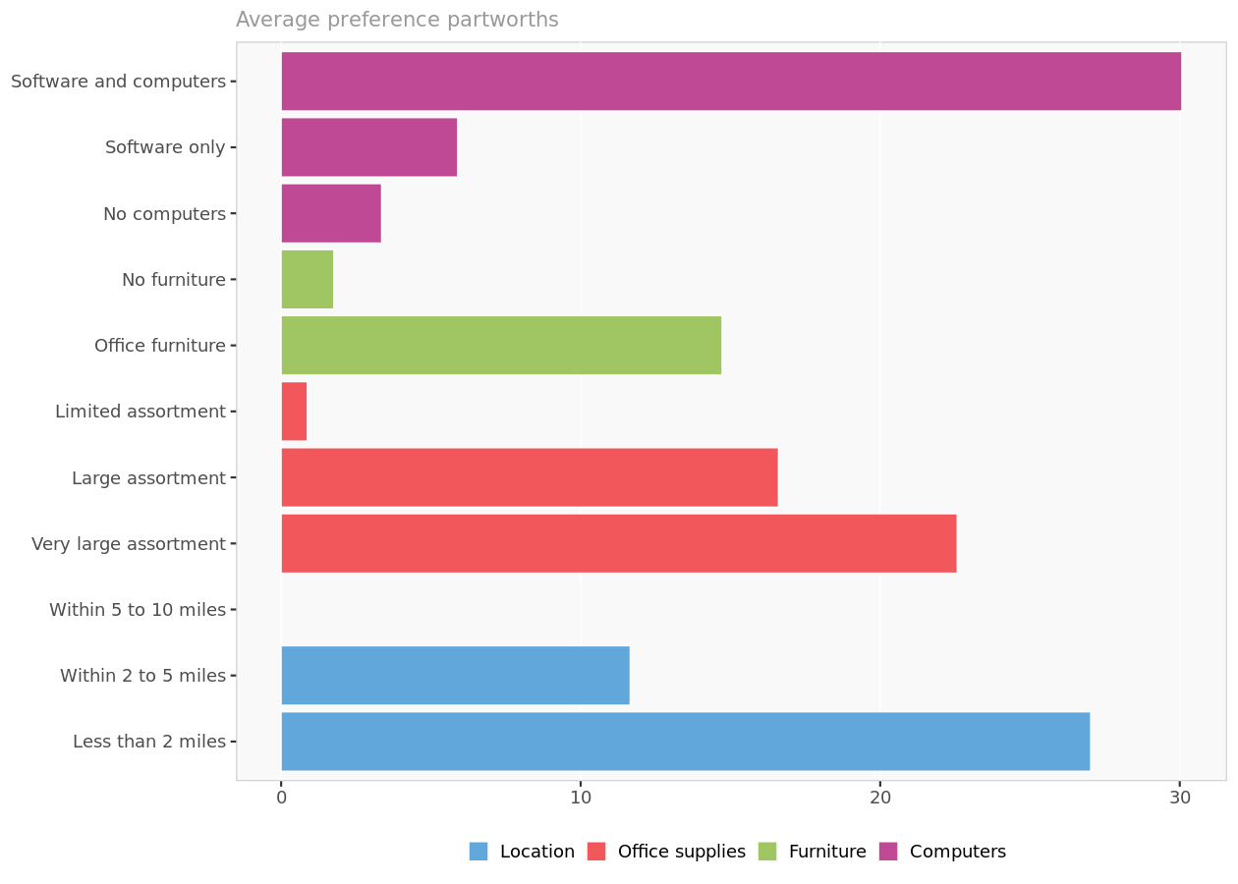
Preference Partworths
Partworth utilities (also known as attribute importance scores and level values) are numerical scores that measure how much each feature influences the customer’s decision to select an alternative
Average preference partworths for each attribute level.

Slide 20
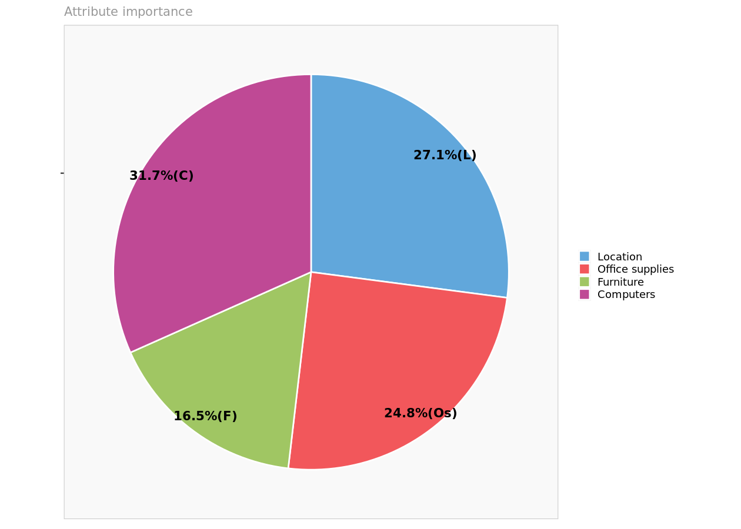
Attribute importance
Reports the maximum level value for each attribute, reflecting the relative importance of each attribute in driving preferences.

Slide 21
Preference partworths (excerpt)⬅ Derived from Respondents' ratings of profiles
 | Less than 2miles | Within 2to5 miles | Within 5to10 miles | Very large assortment | Large assortment | Limited assortment | Office furniture | No furniture | No computers | Software only | Software and computers
Respondent 1 | 28.84 | 23.91 | 0.00 | 3.35 | 4.54 | 0.00 | 52.97 | 0.00 | 4.56 | 0.00 | 13.65
Respondent 2 | 30.76 | 15.35 | 0.00 | 3.22 | 6.50 | 0.00 | 1.72 | 0.00 | 0.00 | 0.97 | 61.01
Respondent 3 | 14.19 | 0.87 | 0.00 | 0.00 | 4.93 | 1.17 | 2.50 | 0.00 | 0.00 | 22.82 | 78.38
Respondent 4 | 16.86 | 16.85 | 0.00 | 46.61 | 21.99 | 0.00 | 8.86 | 0.00 | 0.00 | 16.75 | 27.66
Respondent 5 | 24.27 | 8.64 | 0.00 | 59.04 | 40.66 | 0.00 | 0.00 | 1.50 | 7.84 | 0.00 | 15.19
Respondent 6 | 47.84 | 16.54 | 0.00 | 22.70 | 12.41 | 0.00 | 27.50 | 0.00 | 1.96 | 0.04 | 0.00
Respondent 7 | 30.51 | 15.19 | 0.00 | 0.00 | 5.92 | 1.07 | 52.97 | 0.00 | 7.10 | 0.00 | 10.60
Respondent 8 | 21.99 | 6.15 | 0.00 | 7.26 | 8.66 | 0.00 | 0.00 | 1.15 | 4.14 | 0.00 | 68.21
Respondent 9 | 23.47 | 8.69 | 0.00 | 0.15 | 2.36 | 0.00 | 0.00 | 0.83 | 0.00 | 18.77 | 73.34
Respondent 10 | 17.40 | 17.31 | 0.00 | 43.49 | 20.56 | 0.00 | 11.68 | 0.00 | 0.00 | 14.20 | 27.43
+
100
This table lists, for each respondent, his or her estimated preference partworths, or preferences, for each attribute level. They have been scaled such as the sum of the most preferred levels sum up to 100.

Slide 22
Simulations with existing products

Slide 23
Existing products
 | Location | Office supplies | Furniture | Computers
Office Equipment | Within 2 to 5 miles | Large assortment | Office furniture | Software and computers
Department Store | Within 2 to 5 miles | Limited assortment | No furniture | Software only
Characteristics of products already in the marketplace.

Slide 24
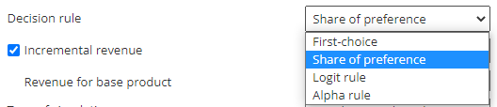
Predicted market shares with different Decision Rules
The decision rule applied to
predict market shares is the
share-of-preference rule.
 | Office Equipment | Department Store
Predicted | 78.8% | 21.2%

Slide 25
Decision Rule to Be Used in the Analysis
First choice rule: Each respondent selects the product that provides the highest utility among competing products and a specific new product concept being evaluated. If customers buy products in the product category infrequently and/or are highly involved in the purchase decision (e.g., house, car, expensive computer), the maximum utility rule is the preferred option.
Share of preference rule: Each respondent’s share of purchases of a particular product is a function of his or her preference for that product, compared with the total preference for all products in the competitive set. This analysis option is most suitable for products that customers buy frequently and/or for which they are less involved in the purchase decision (e.g., beer, toothpaste, restaurant).
Logit choice rule: The share of each product for each respondent is a function of the weighted utility for that product, compared with the total weighed utility for all products in the competitive set. The weighting uses an exponential function. This analysis option provides an alternative to the share of utility model. The Logit choice rule is only available when current market shares is selected.
Alpha rule: A weighted combination of the maximum utility rule and the share of utility rule, this method chooses a weight (alpha) that ensures the market shares computed in the simulation are as close as possible to the actual market shares of the existing products in the market. This option is available only if you provide information about the market shares of existing products in the segment to which you are targeting the new product. The Alpha rule is only available when current market shares is selected.

Slide 26
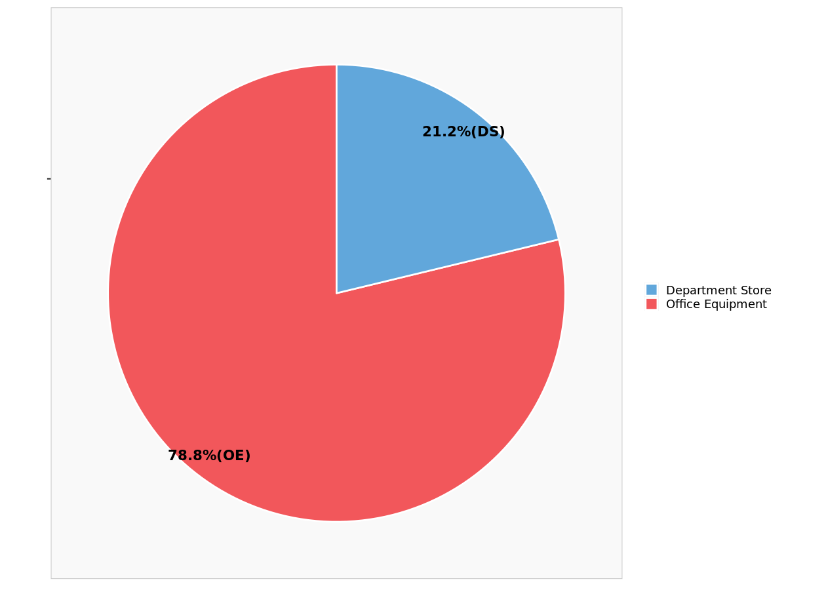
Predicted market shares

Slide 27
Detailed predictions (excerpt)
 | Office Equipment | Department Store | Office Equipment | Department Store
Respondent 1 | 95 | 24 | 79.9% | 20.1%
Respondent 2 | 85 | 16 | 83.8% | 16.2%
Respondent 3 | 87 | 25 | 77.7% | 22.3%
Respondent 4 | 75 | 34 | 69.2% | 30.8%
Respondent 5 | 64 | 10 | 86.4% | 13.6%
Respondent 6 | 56 | 17 | 77.3% | 22.7%
Respondent 7 | 85 | 16 | 83.9% | 16.1%
Respondent 8 | 83 | 7 | 91.9% | 8.1%
Respondent 9 | 84 | 28 | 74.9% | 25.1%
Respondent 10 | 77 | 32 | 71.0% | 29.0%

Slide 28
Simulations with optimal products

Slide 29
Optimal products
Based on the number of attributes and attribute levels, there is a total of 18 (1 x 3 x 2 x 3=18) possible product combinations.(assuming location has only 1 level that is limited to Within 5 to 10 miles) We report the characteristics of the 3 non-dominated products among those 18 combinations. A product is said to be non-dominated (不可支配解) when there is no other product that provides at the same time a higher predicted market share and a higher weighted revenue.

Slide 30
Optimal products
 | Location | Office supplies | Furniture | Computers
Optimal product 1 | Within 5 to 10 miles | Large assortment | No furniture | Software and computers
Optimal product 2 | Within 5 to 10 miles | Large assortment | Office furniture | Software and computers
Optimal product 3 | Within 5 to 10 miles | Very large assortment | Office furniture | Software and computers
Characteristics of optimal products (products are Pareto optimal/efficient) potentially introduced in the marketplace.
Pareto efficiency or Pareto optimality (not a optimal solution) is a situation where no individual or preference criterion can be better off without making at least one individual or preference criterion worse off or without any loss thereof.

Slide 31
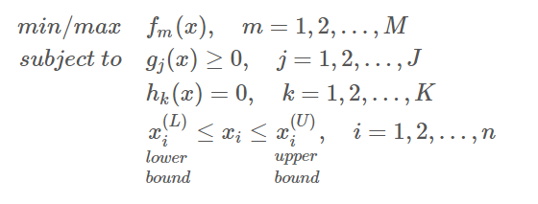
多目标优化问题（Multi-Objective Optimization, MOO）
形式化定义
_{特点}
包含多个可能有冲突的目标函数 (又要馬兒好,又要馬兒不吃草。)
希望找到能够很好平衡全部优化目标的解集 (魚與熊掌不可兼得)
不可支配解➔沒有任何其他解能在所用目標下都勝過此解。
https://hpzhao.github.io/2018/09/17/多目标优化四种方法/

Slide 32
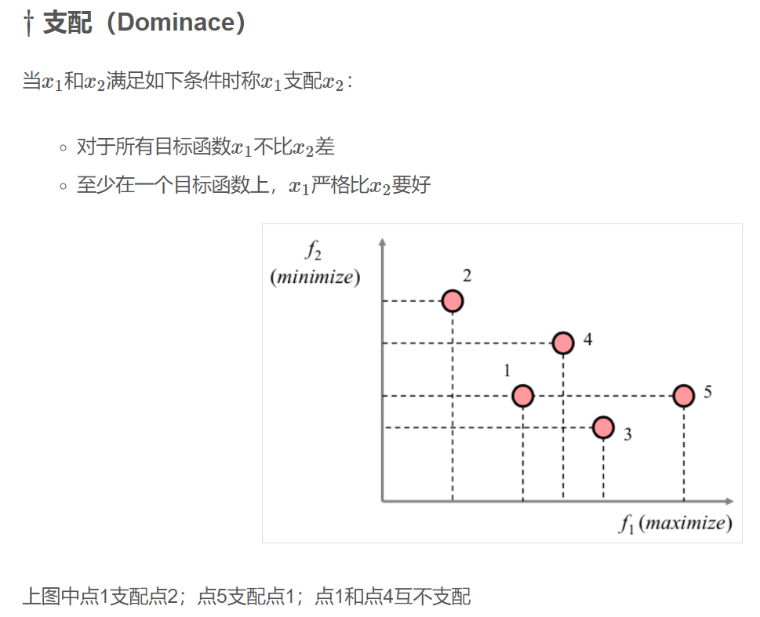




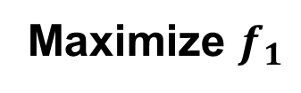

多目标优化
Minimize $f_{2}$
Maximize $f_{1}$
https://hpzhao.github.io/2018/09/17/多目标优化四种方法/

Slide 33
Pareto frontier
The chart below displays all the possible product combinations in terms of weighted revenue (horizontal axis) and predicted market shares (vertical axis).
The red dots represent the non-dominated products, that is, the products for which there exists no alternative that provides at the same time higher market shares and higher weighted revenue. The labels next to them indicate their index in the table below.
The grey dots represent dominated products.
The red line represents the Pareto frontier, linking all non-dominated products together. (不是最佳解, 但是也沒有產品在各方面都贏過我。) 最佳解➔ 各方面都勝出。

Slide 34
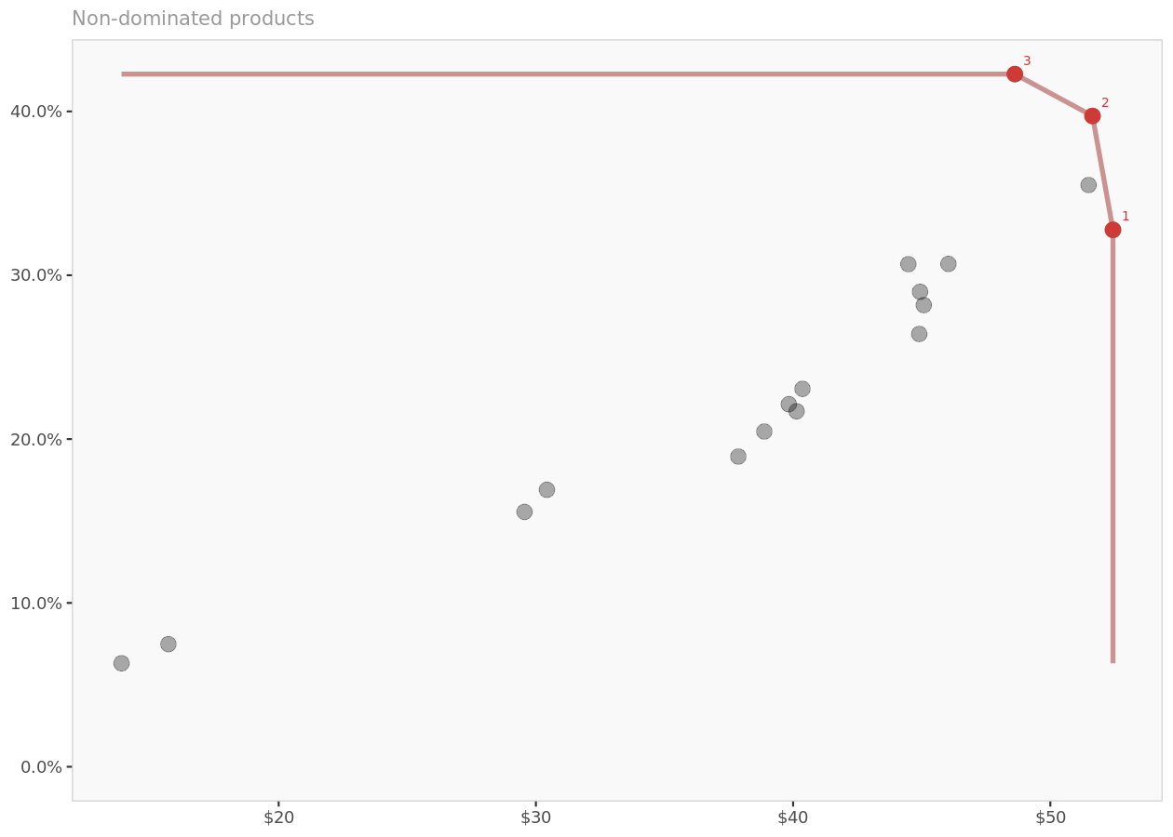
Pareto frontier 帕累托边界
帕累托最优是指资源分配的一种理想状态。給固有的一群人和可分配的资源，如果从一种分配状态到另一种状态的变化中，在没有使任何人情况变坏的前提下，使得至少一个人变得更好，这就是帕累托改善。帕累托最適的狀態就是不可能再有更多的帕雷托改善的狀態；换句话说，不可能在不使任何其他人受損的情況下再改善某些人的情況。
产品混合最优：经济体产出产品的组合必须反映消费者的偏好。此时任意两种商品之间的边际替代率必须与任何生产者在这两种商品之间的边际产品转换率相同。
帕累托边界 Pareto frontier 是所有帕累托有效分配的集合，按惯例以图表形式表示它。它也被称为
帕累托前沿 Pareto front 或
帕累托集 Pareto set 。 (link)
Market share
Weighted revenue
Non-dominated products (in terms of market shares and weighted revenue) are in red, dominated products are in gray, and the red line represents the Pareto frontier.
Notes:
B - Non-dominated solutions and the Pareto frontier
Generally, in multi-objective optimization there is a single best solution for each objective value. However, in all the other objective values this solution might not fare that well. Therefore, in multi-objective optimization, the non-dominated solutions are the ones that form the set of most interesting solutions. Each solution will exhibit some type of trade-off, which cannot be decided a priori (i.e. combined into a single fitness value) but needs to be explored a posteori.
For multi-objective optimizations with m as number of objectives, each solution can be located based on its objective values in an m-dimensional space.
A solution S1 dominates a solution S2 if all of S1’s objective values are better than the corresponding objective values of solution S2.
A solution S1 is dominated by a solution S3 if all of S3’s objective values are better than the corresponding objective values of S1.
A non-dominated solution S3 is a solution that is not dominated by any other solution SN. Note that this does not mean that a non-dominated solution S3 performs better in all objectives than all other solutions. It only means that there is no other solution SN that performs better in all objectives than the non-dominated solution S3. Another solution S4, that performs better in at least one objective is neither dominated by nor does it dominate solution S3. However, we cannot know whether S4 itself is non-dominated, or whether there are other solutions that dominate S4. For that we have to perform a Pareto-dominance check for S4, effectively comparing S4’s fitness values with the fitness values of all other solutions.
Note that this other solution (e.g. S4 in relation to S3) and all other solutions for which some objective values are better and some worse fall out of both areas of Pareto-dominance (i.e. dominated by S3 or dominating S3). These other solutions are in an indifferent Pareto-dominance state to the solution with which they are compared.

Slide 35
Simulation results
Predicted market shares
 | Office Equipment | Department Store | Optimal product | Revenue per unit | Weighted revenue
Base predictions | 78.8% | 21.2% | N/A | N/A | N/A
...with optimal product 1 | 53.0% | 14.2% | 32.8% | $ 160.0 | $ 52.4
...with optimal product 2 | 47.3% | 13.0% | 39.7% | $ 130.0 | $ 51.6
...with optimal product 3 | 45.4% | 12.3% | 42.3% | $ 115.0 | $ 48.6
Predicted market shares, revenue per unit, and weighted revenue (i.e., revenue per unit multiplied by predicted market shares) for each optimal product.
If marketing share is more importance than revenue, we may choose optimal product 3.

Slide 36
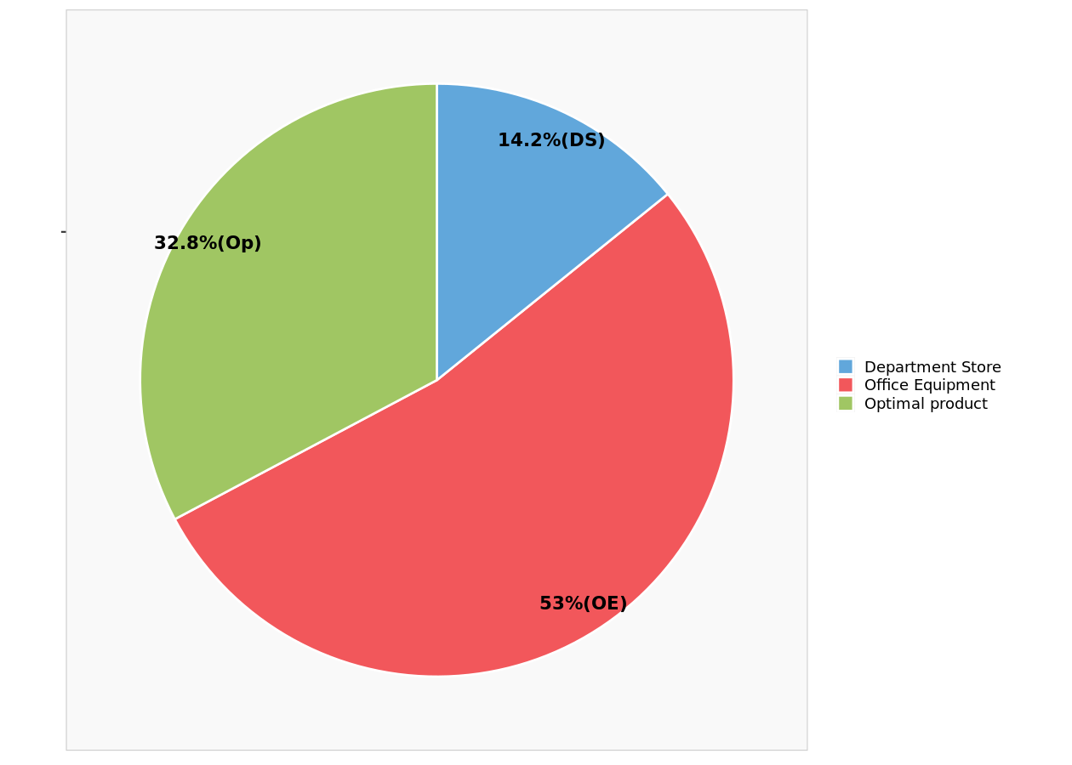
Predicted market shares ...with optimal product 1

Slide 37
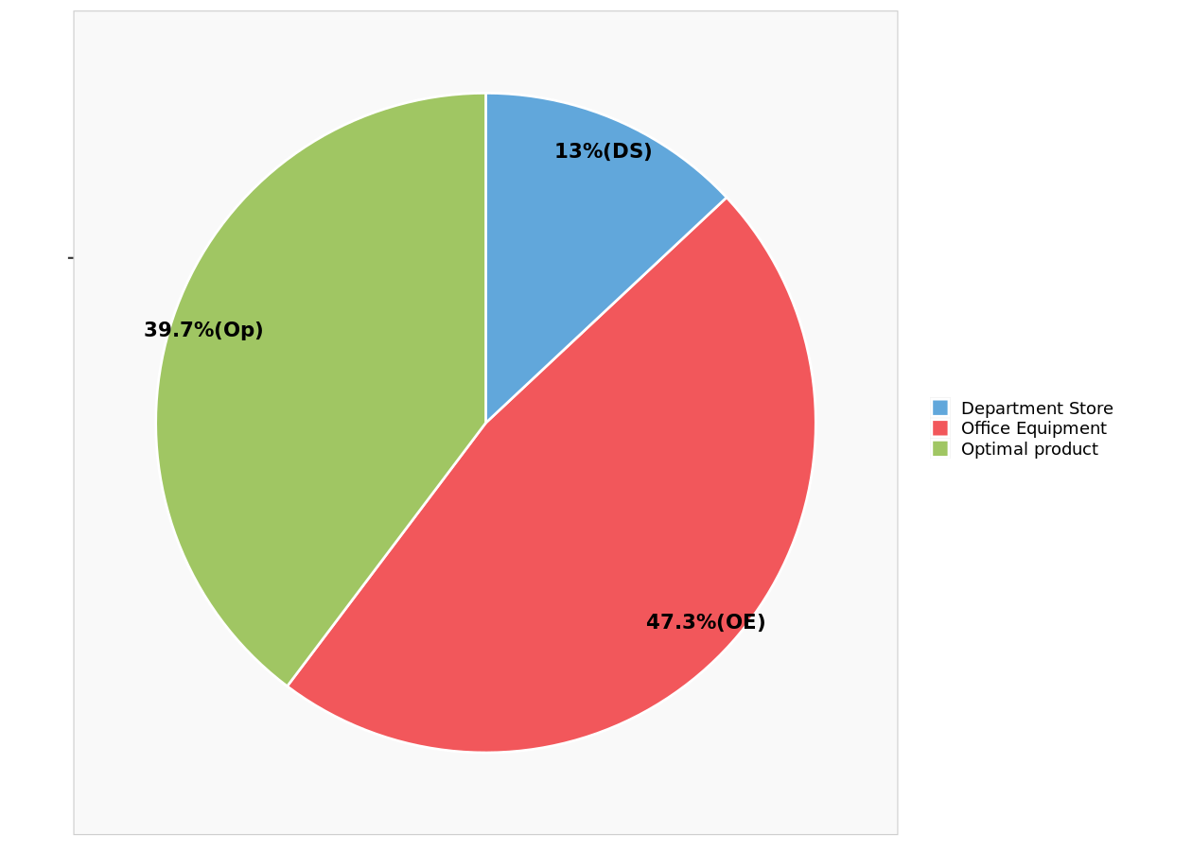
Predicted market shares ...with optimal product 2

Slide 38
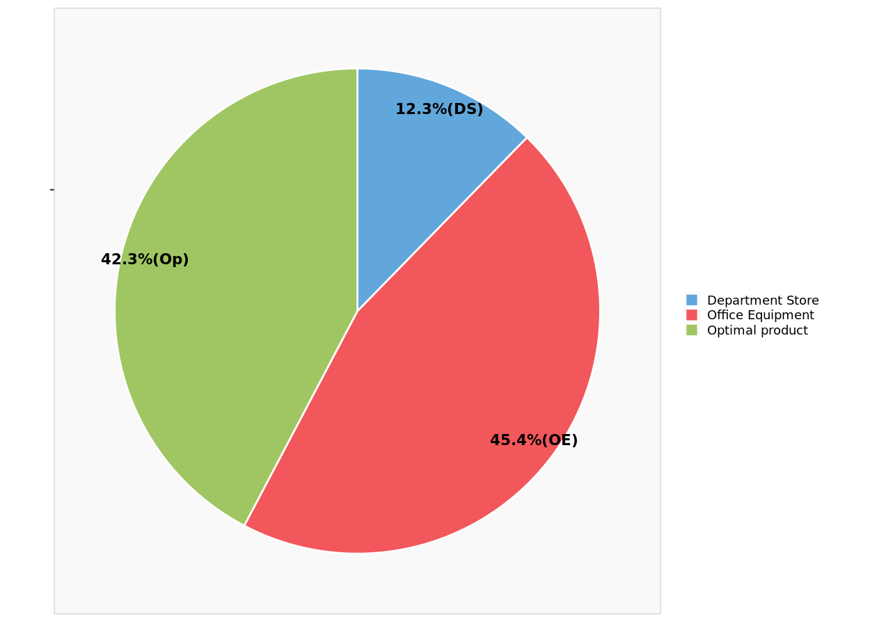
Predicted market shares ...with optimal product 3

